Slide 1
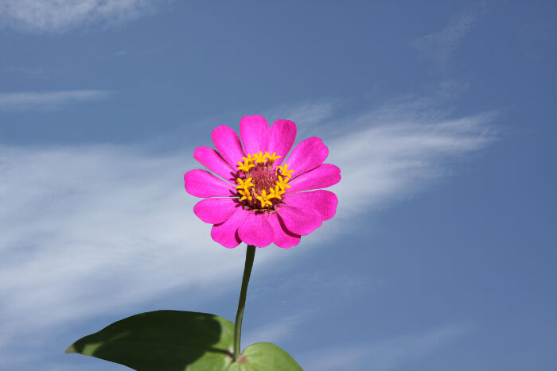
How are you?
welcome

Slide 2

Teacher’s Identity
Rajesh majumder
Assistant Teacher
Enayetnogr Govt. Pry. School
Dagonbhuiyan, Feni

Slide 3

Lesson Identity
Class : Five
Subject : English
Unit : 20
Lesson : 1-2 A ( It’s a – for school)

Slide 4
Learning Outcomes
Students will be able to :
1.5.1 read words, phrases and sentences in the text
with proper pronunciation, stress and intonation.
3.3.1understand questions about objects around them.
3.4.1 understand statements made by the teacher and
Students.
5.1.1 read silently with understanding paragraph.
3.1.2 write, words, phrases and sentences using
non-cursive small letters..

Slide 5
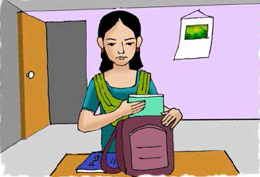
creating
Emotion
Declear the
lesson
Now I’m going to show you a picture.
Students, please watch this picture attentively .
Life is beautiful.
What do you see
in this picture?
What is the girl doing in the picture?

Slide 6
Do you know the meaning
of the words?
Word | Meaning
Spring | Name of the season
Smell | Flavor
Dressed | Wearing
Warm | Hot
Spring, Smell,
Dressed, Warm

Slide 7

Connection with Textbook
Find out the words.
Please open page no 79 of textbook.
Spring, Smell,
Dressed, Warm

Slide 8
It’s spring day.
It’s a beautiful spring day. Maria gets up early. She feels happy. She knows that it’s a nice day because she puts her hand on the glass of the window. It is very warm. She opens the window and the singing of the birds fills the room. She can smell the flowers outside her home. They smell sweet and fresh. After Maria gets dressed and has her breakfast, she puts her books in her bag. She is ready for school.
Teacher’s reading
Maria gets up early.
It is very warm.
Important information about
The lesson are…
Maria opens the window .
Dear students, listen
attentively.
Maria gets smell sweet
and fresh of flowers .
Maria gets dressed, has breakfast then she puts books in bag.

Slide 9
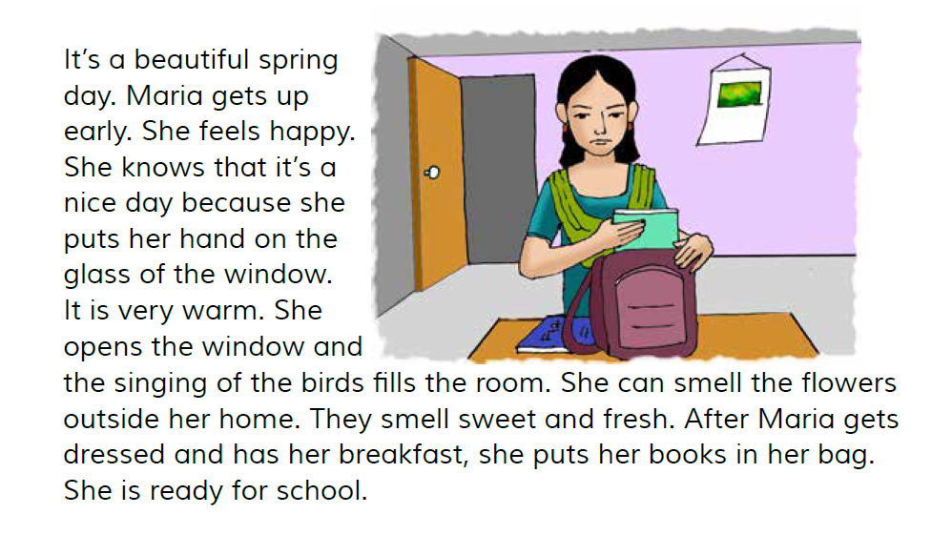
Pair work
silent reading
Everyone practice reading in pair.
Students , please read
the text silently
and try to understand.

Slide 10
It’s a beautiful summer day. Maria gets up late. She feels happy. She knows that it’s a nice day because she puts her hand on a glass of water. It is very warm. She opens the door and the singing of the birds fills the house. She can smell the trees outside her home. They smell sweet and fresh. After Maria gets dressed and has her breakfast, she puts her pens in her bag. She is ready for school.
Now I repeat the lesson. If you get any mistake, you will say stop. Then I will stop after that you will say the correct word.

Slide 11
Group work
Fill in the Gap with the
given word from the box
Spring, hot, puts, feels
It’s a beautiful spring spring day.
It’s a beautiful _______ spring day.
Maria puts her books in bag.
Maria_______ her books in bag.
It is very hot.
It is very_______.

Slide 12
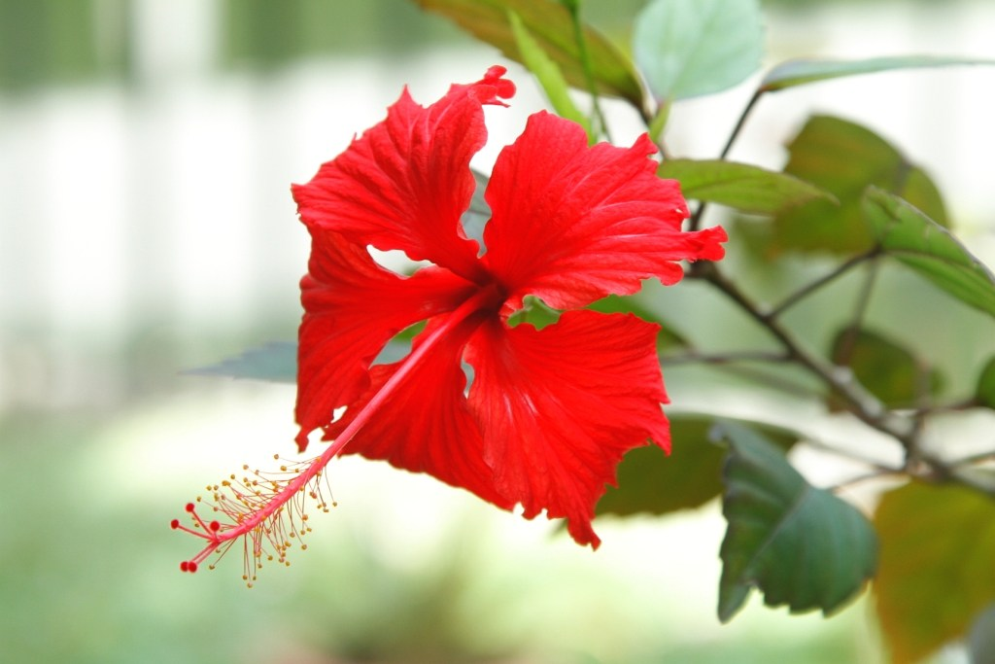
Evalution
Thank you, Students
Match the word in column A with their meaning in column B (extra one given)
Beautiful
Worm
Smell
Breakfast
Flavor
Nice
Hot
Morning meal
Close
What is the session?
Where does Maria gets up?
Beautiful
Worm
Smell
Breakfast
Flavor
Nice
Hot
Morning meal
Close
Where from Maria gets smell?
Beautiful - Nice
Where does Maria puts her book?
Worm - Hot
Smell - Flavor
Good Bye!
Breakfast - Morning meal

